Slide 1
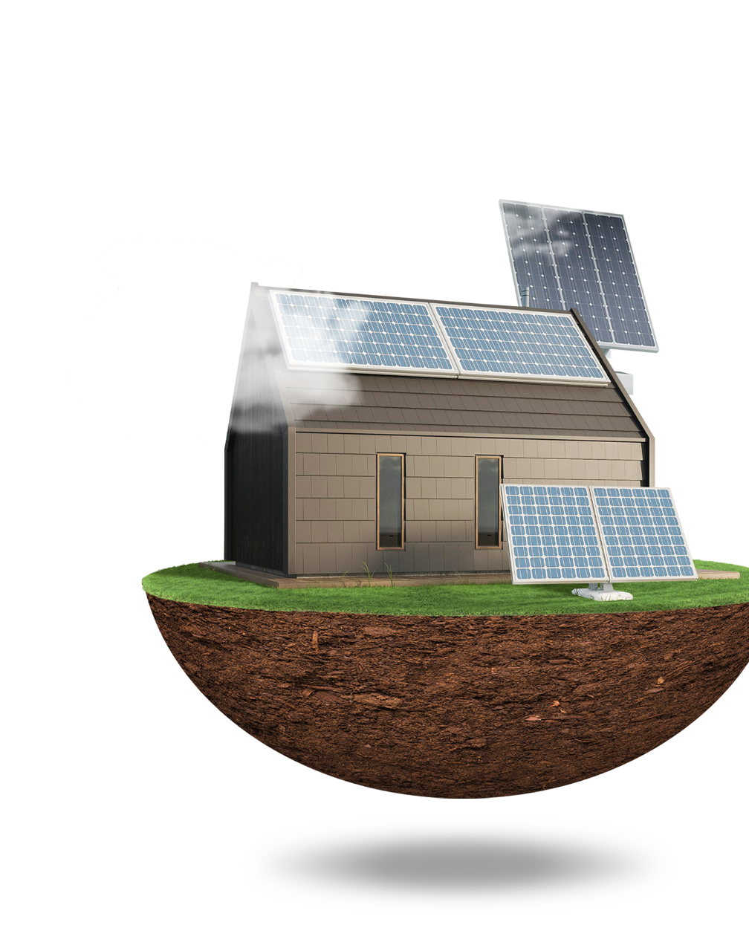
SOL: Remote monitoring and control system for a small-scale stand alone solar plant
Client - Prof. Malay Mazumder
Alexa Wiencek, Angelo Soyannwo, Majid Al-Muhaideb, Rahat Mahmood, Steven Cheng

Slide 2
TABLE OF CONTENTS
01
02
03
04
05
Project Overview
Current Status
Brief top-level view of the project
Update on current situation
Next Steps
Gantt Chart
Description of key objectives to complete
Overview of the Gantt Chart
Conclusion
Retrospective & summary

Slide 3
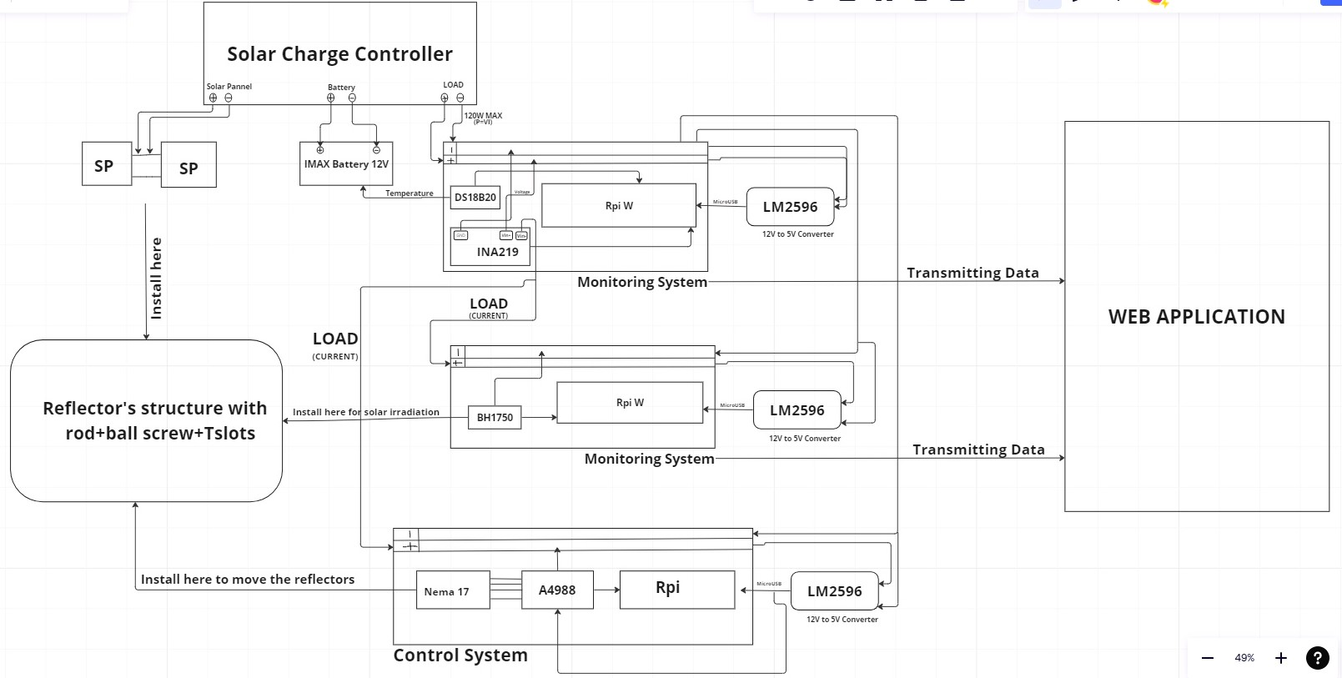
Overview
Give a brief description of the project.
Rahat

Slide 4
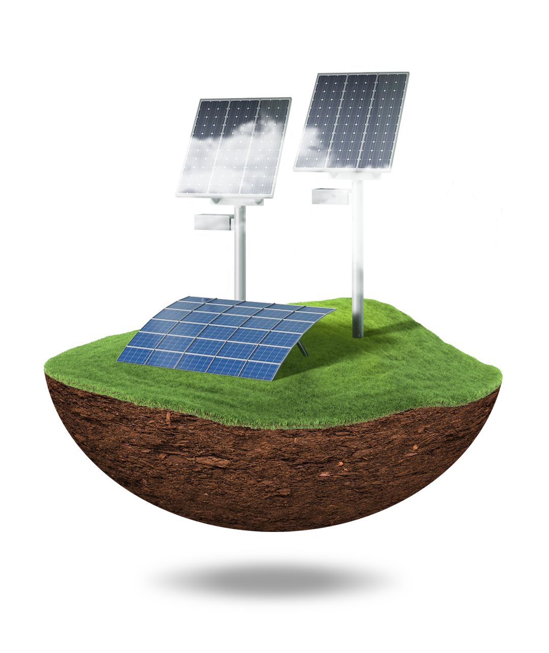
Current Status

Slide 5
Our project has entered the testing phase
Summary of Current Status
Mont. System Cmplt.
Cntrl. System Improved
Reflector System Finished
Gantry/Frame Machined
Web App in Beta Phase

Slide 6
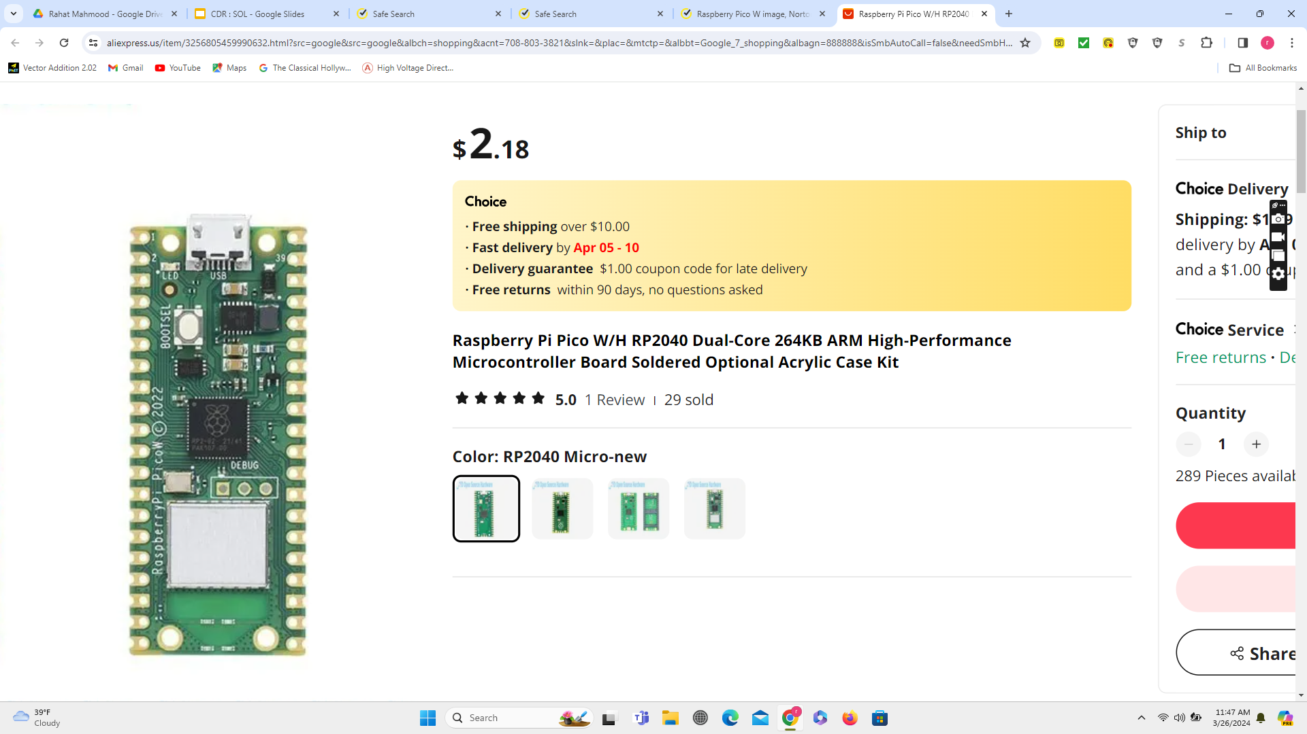
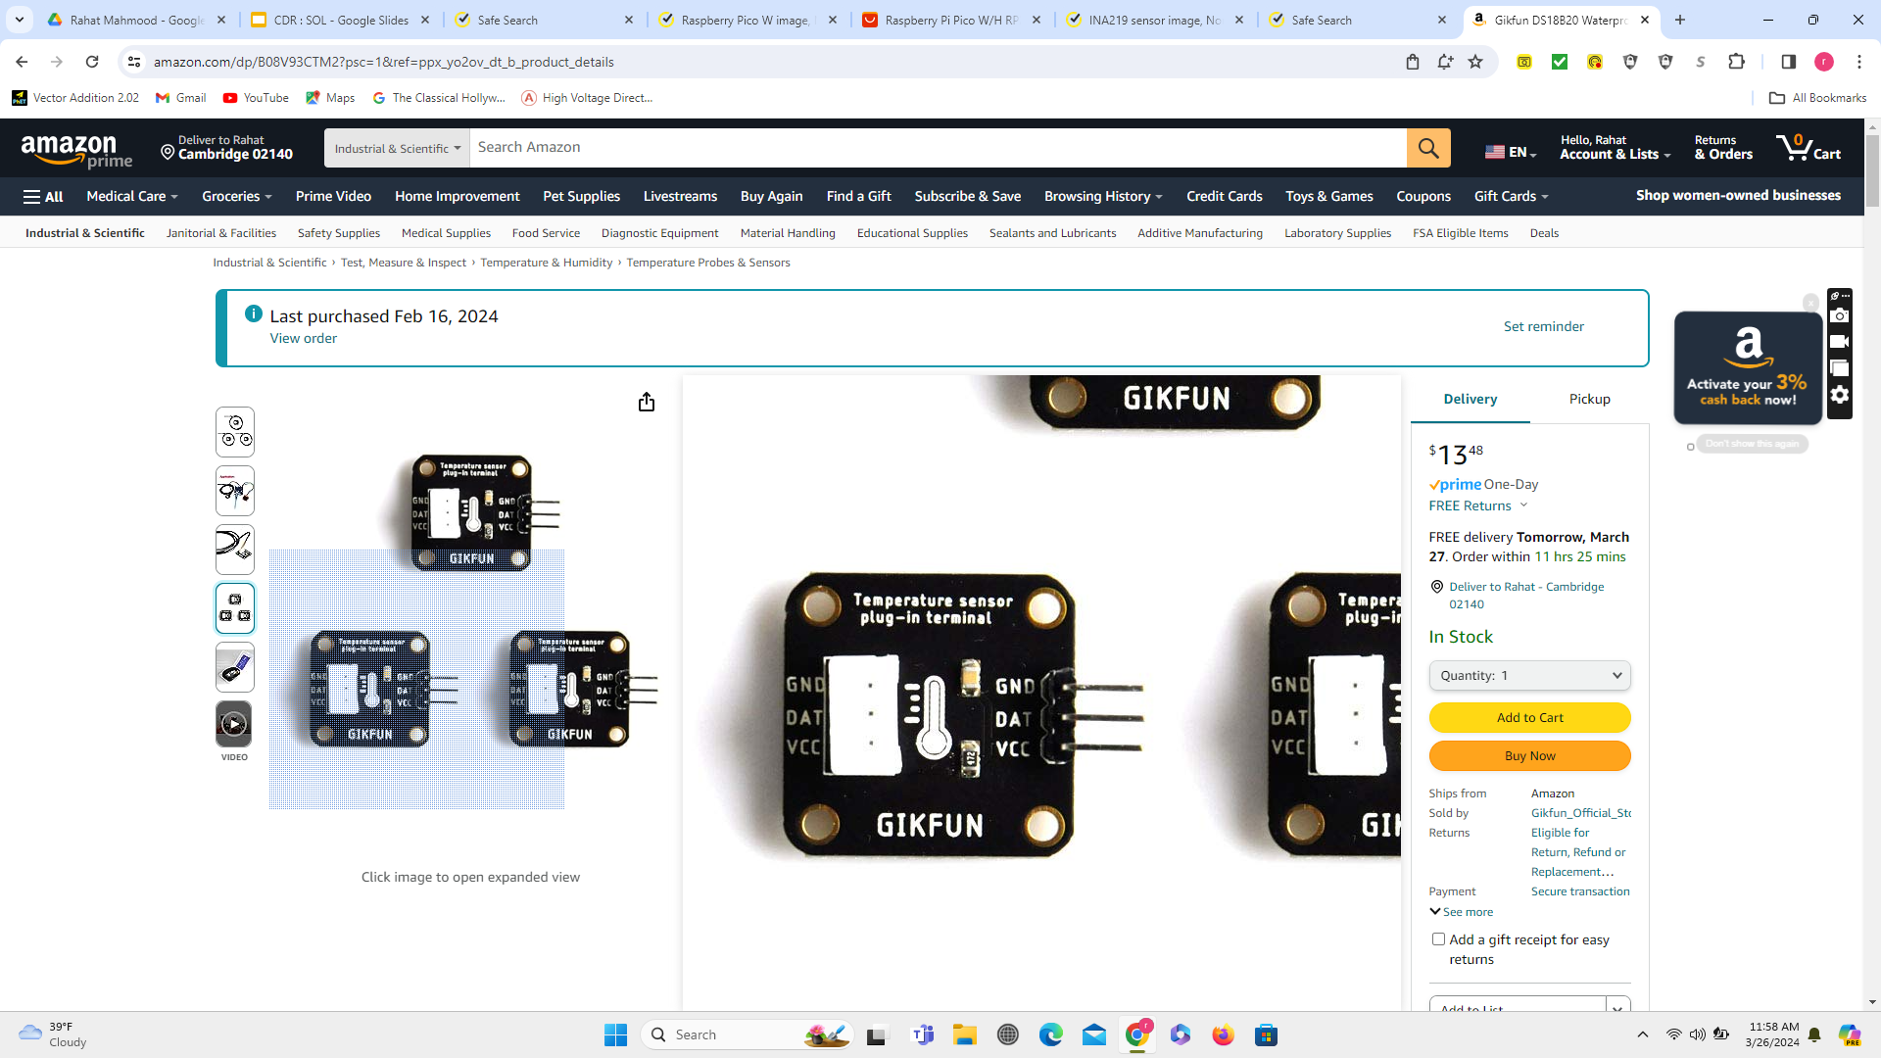
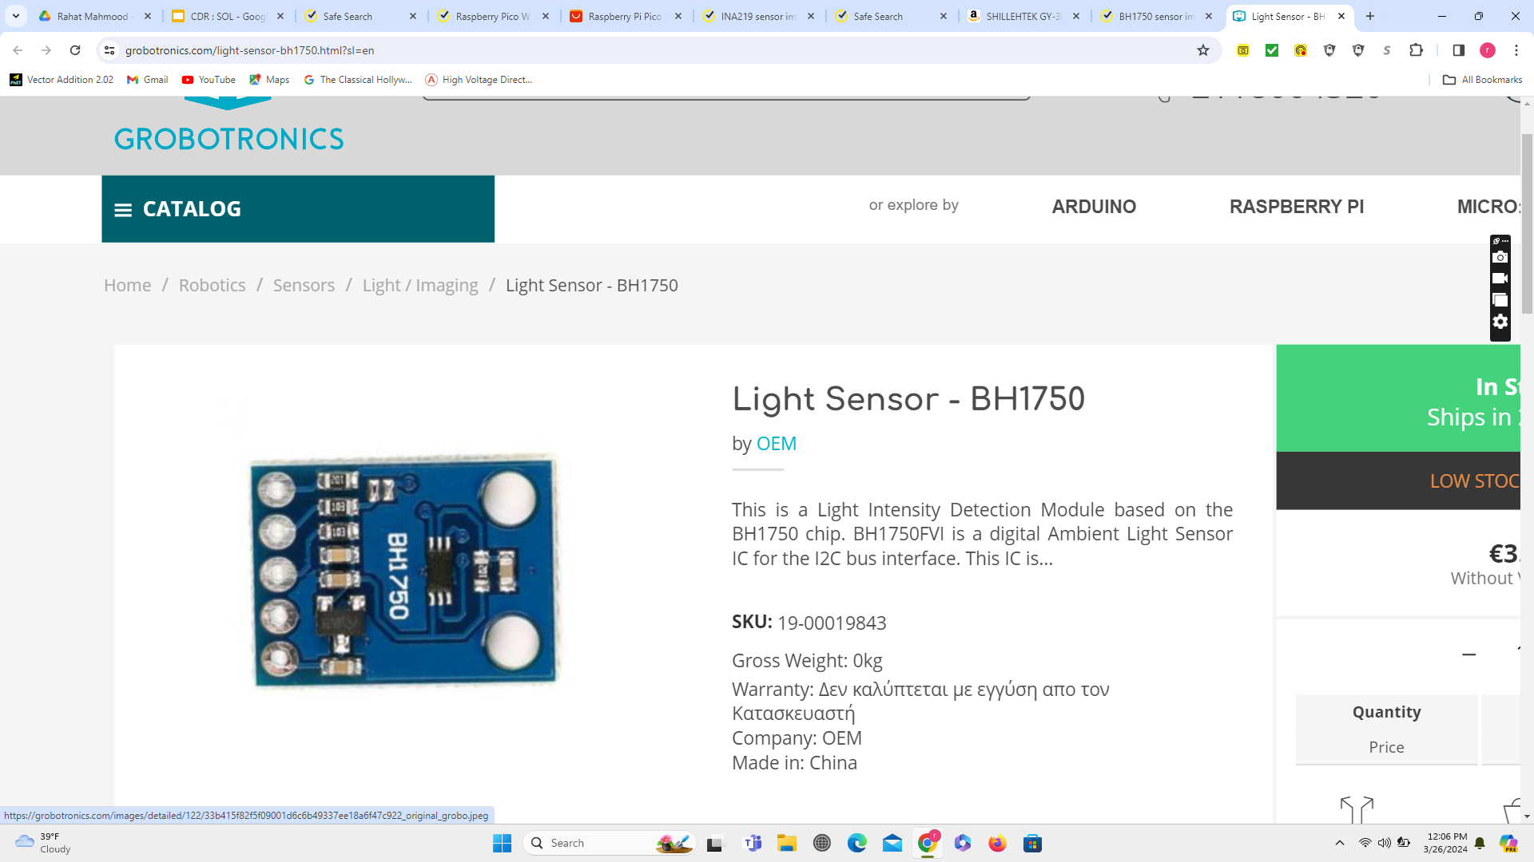
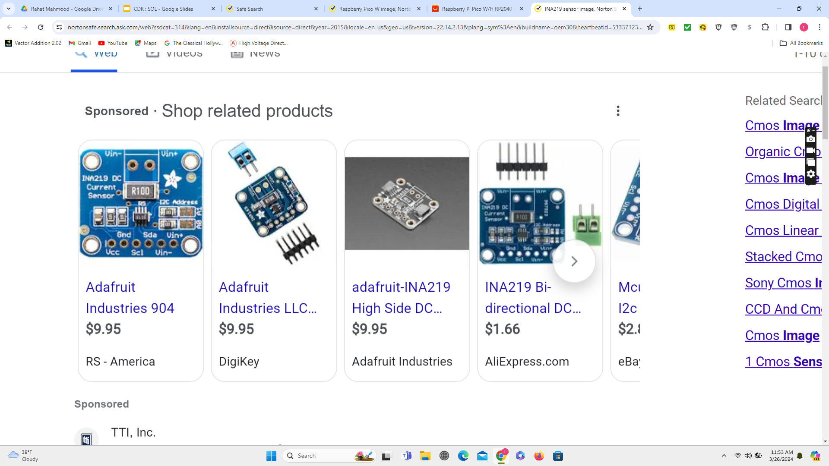
Monitoring System Status (Complete)
Rpi W
I
INA219 (For current-voltage) DS18B20 (For Temperature) BH1750 (For light intensity)
Web Application
Remote User
Transmitting
Transmitting
Transmitting

Slide 7
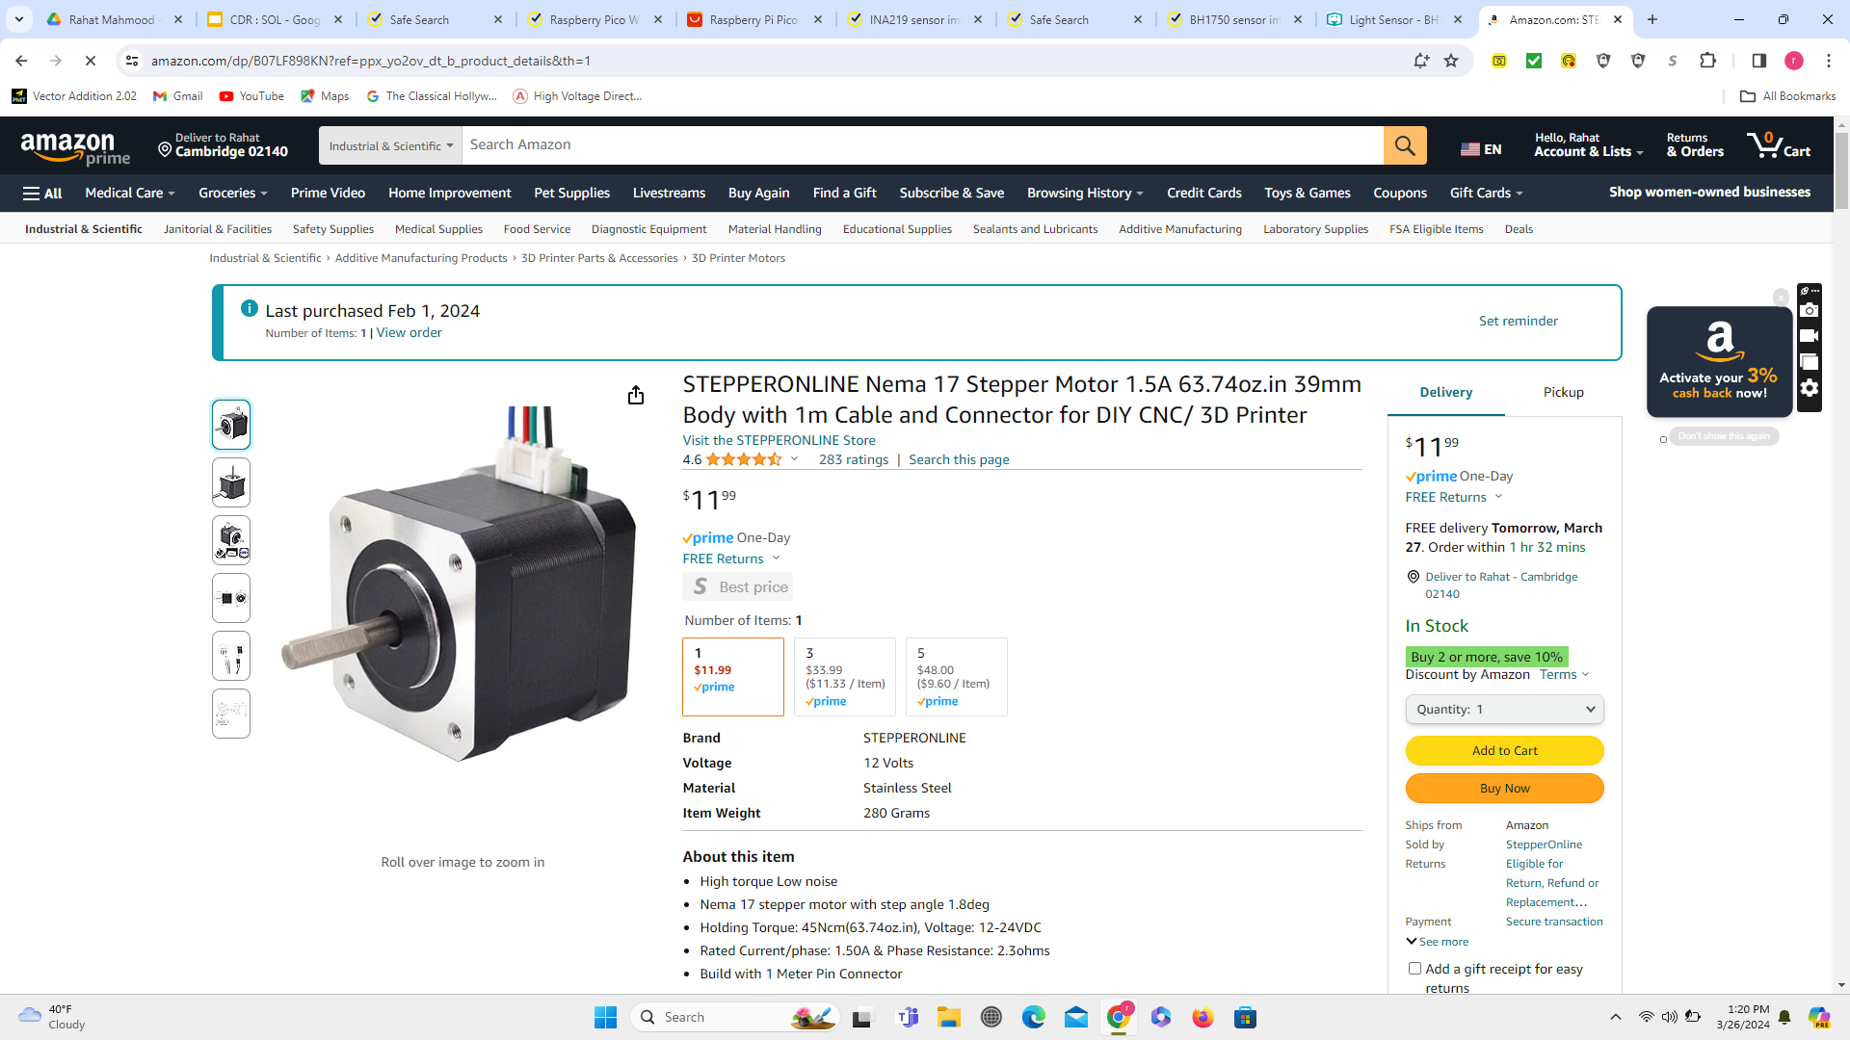
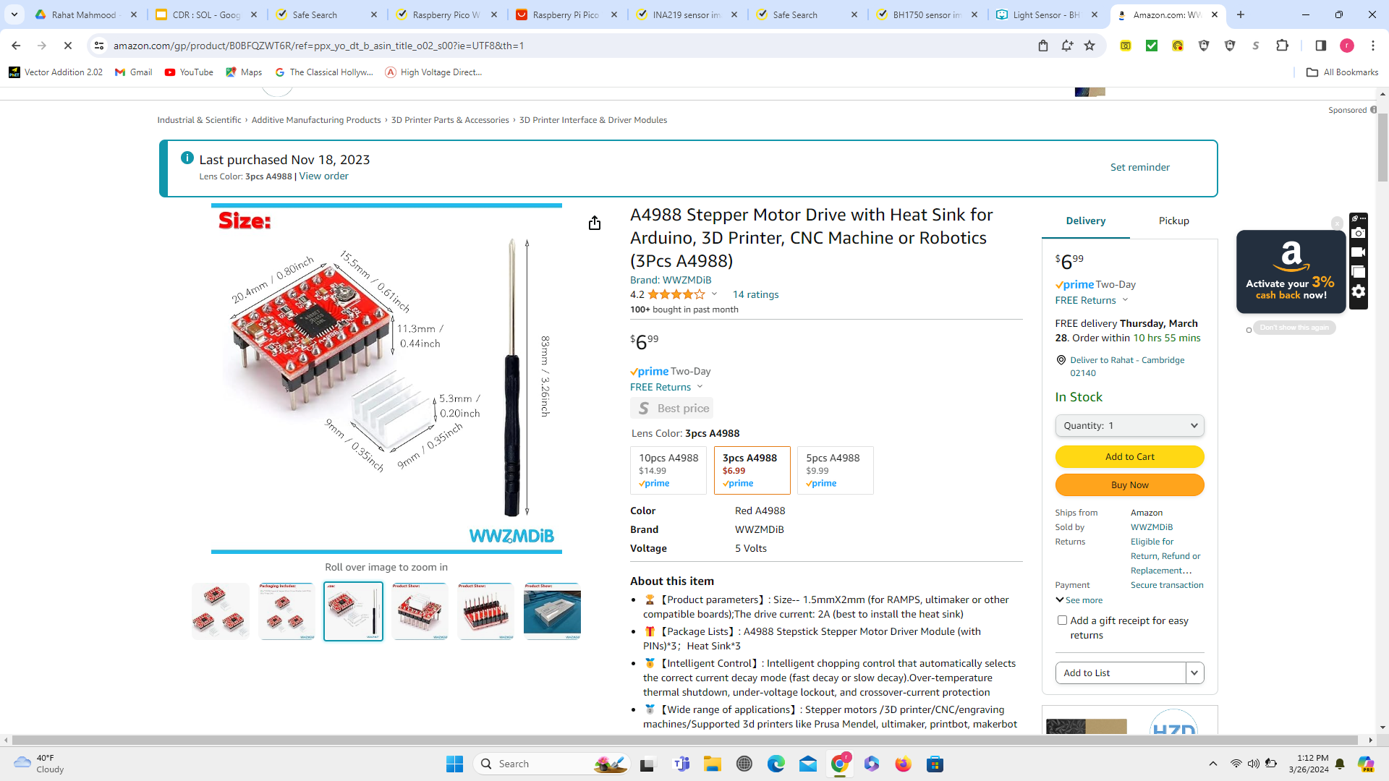
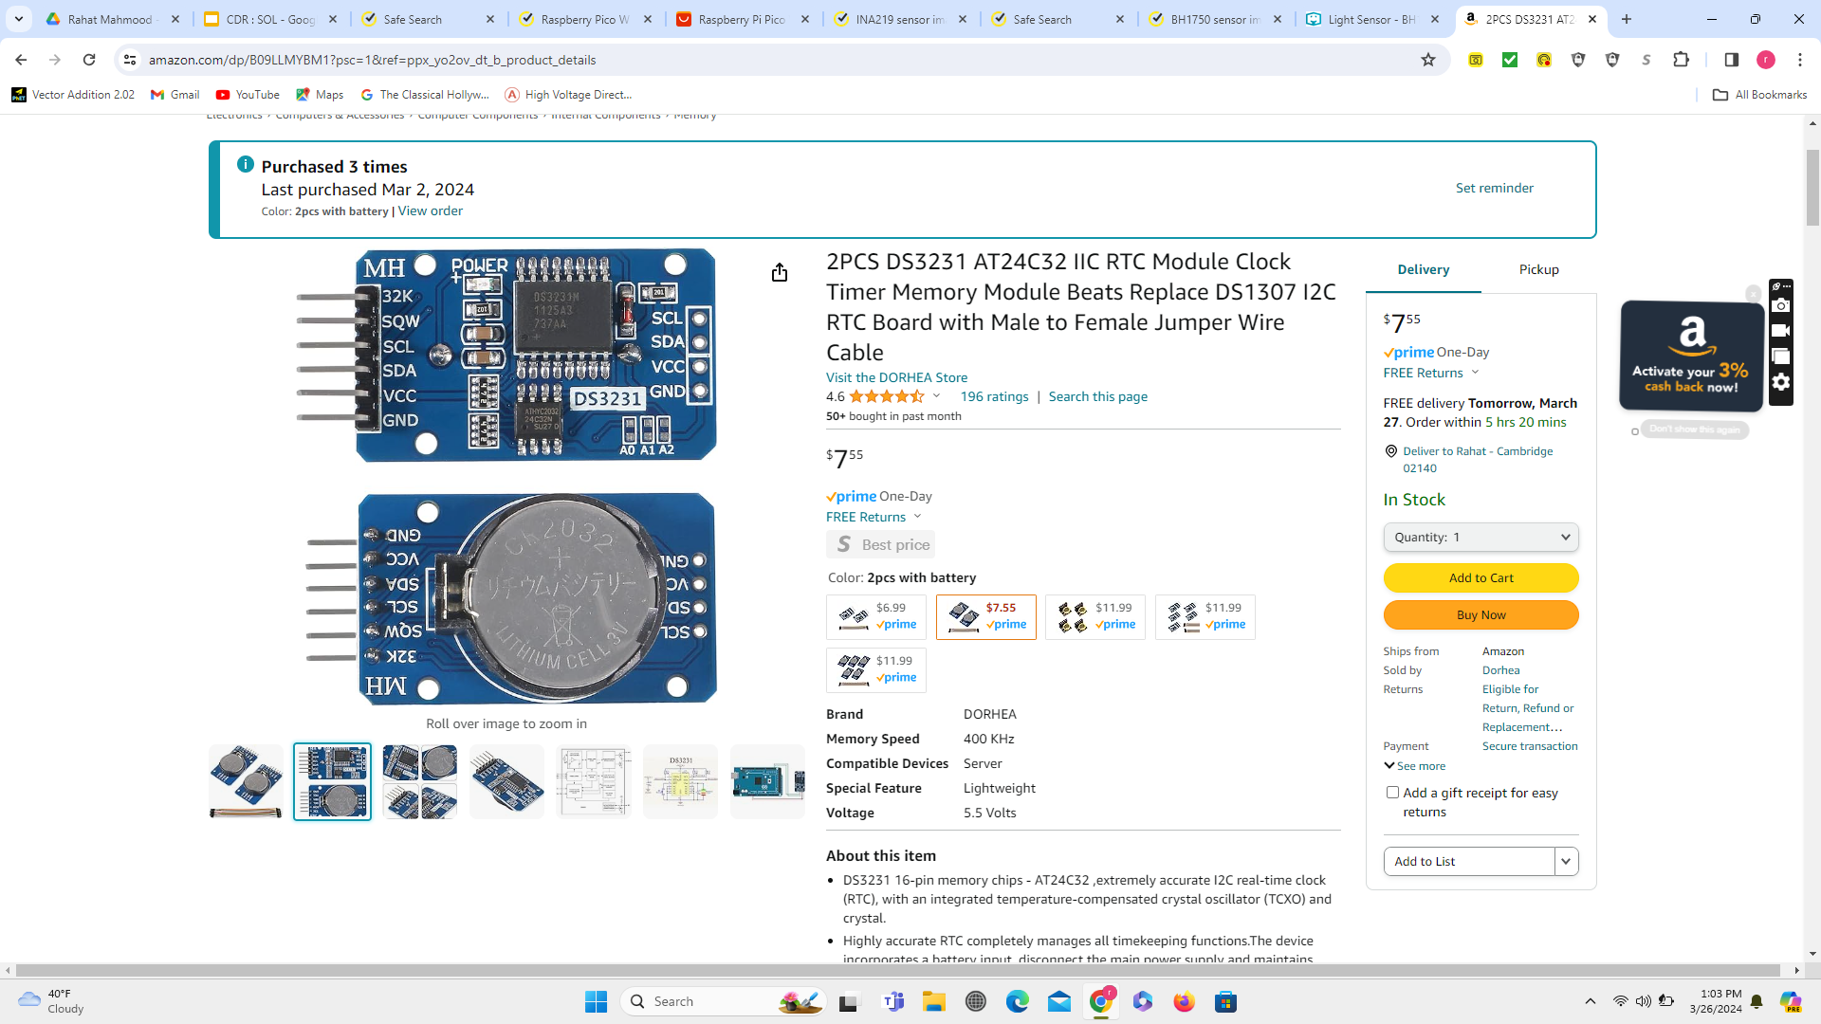
Control system (old design, 2023)
RTC DS3231
Sending Pulse
Driving motor
Moving Reflectors
Reflectors
Motor Driver
Stepper Motor

Slide 8
Control System Status (Improved Design,2024)
Issue | Solution
Software not robust enough, unable to demonstrate easily | Restructure program, implement adjustable system variables
Redundant external RTC | Implement automatic RTC calibration – Startup, WiFi, NTP
Unable to connect to NTP | Add LCD screen, manual RTC calibration
Lose track of reflector position on shutoff | Add manual motor control, users move reflectors back to bottom on startup
Need more user control | Enable users to adjust start of day, end of day, and mid-day pause time on LCD

Slide 9
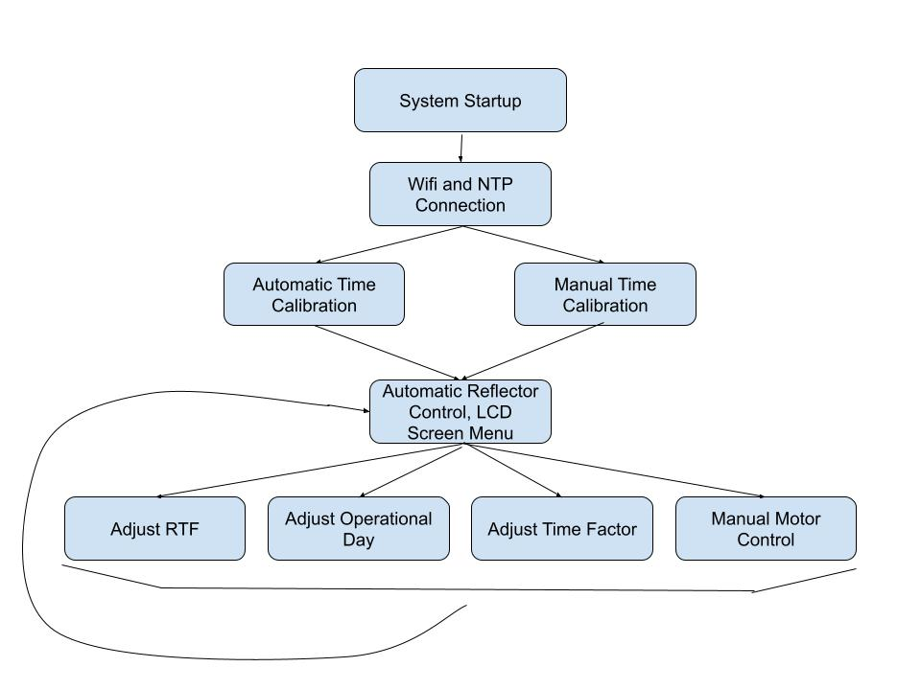

Slide 10
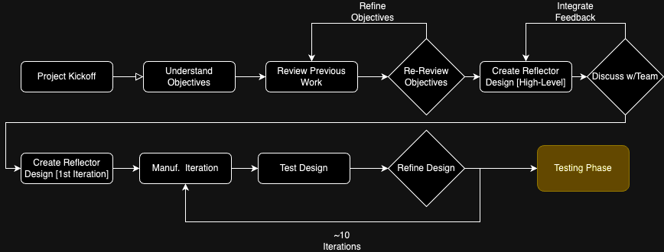
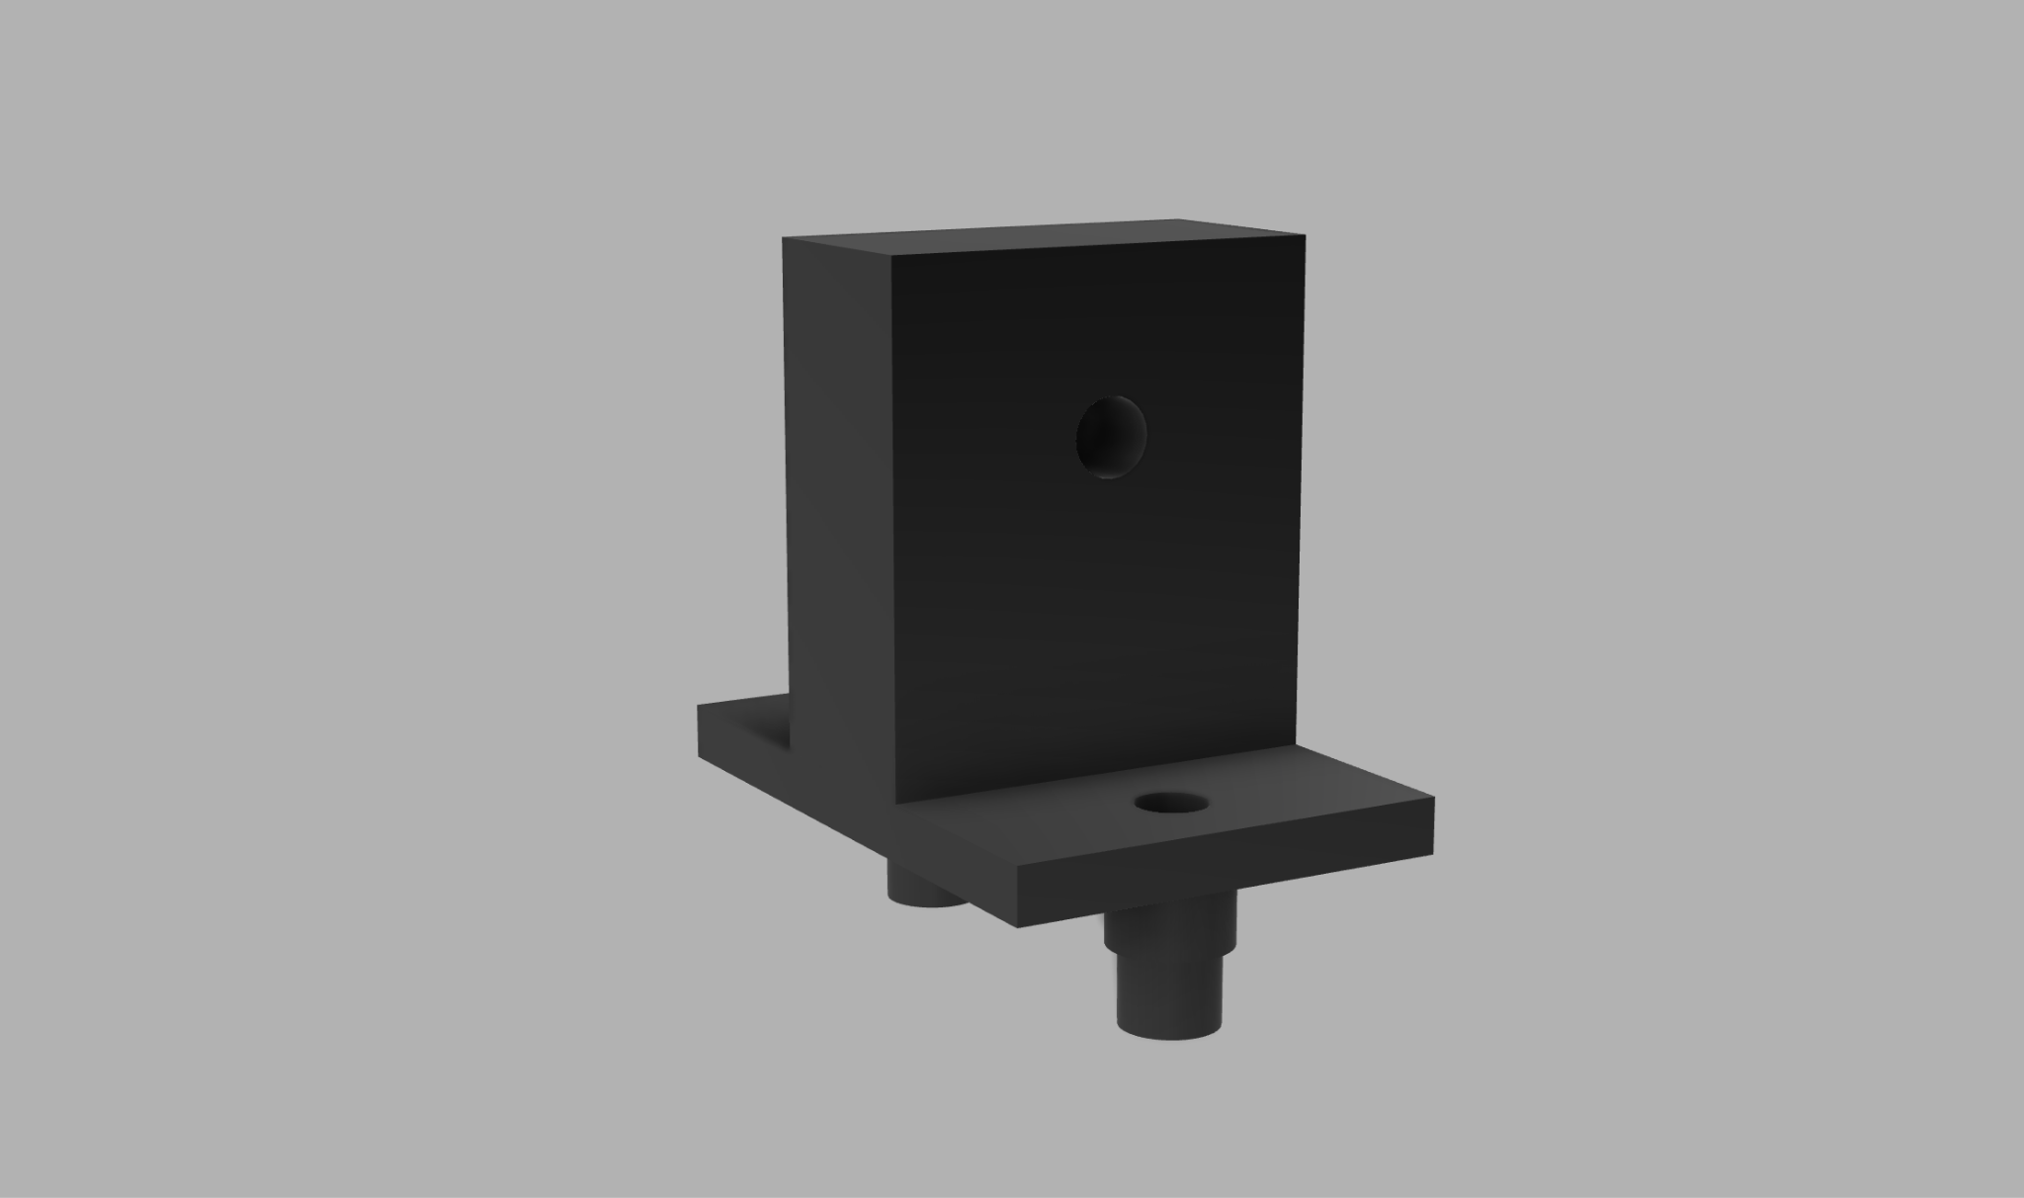
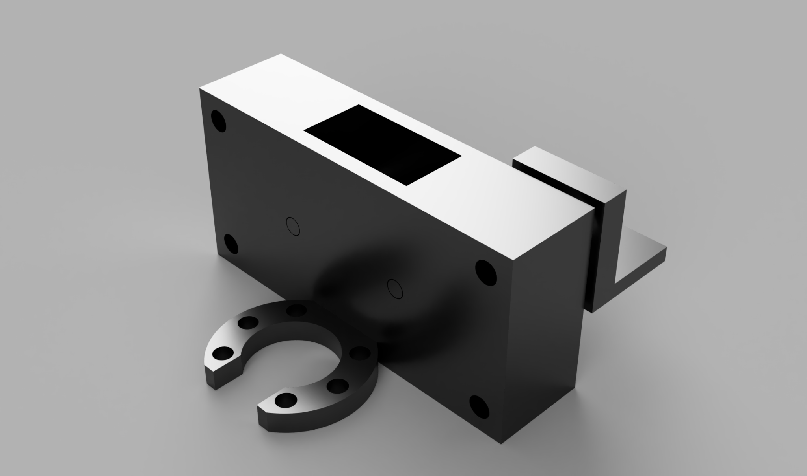
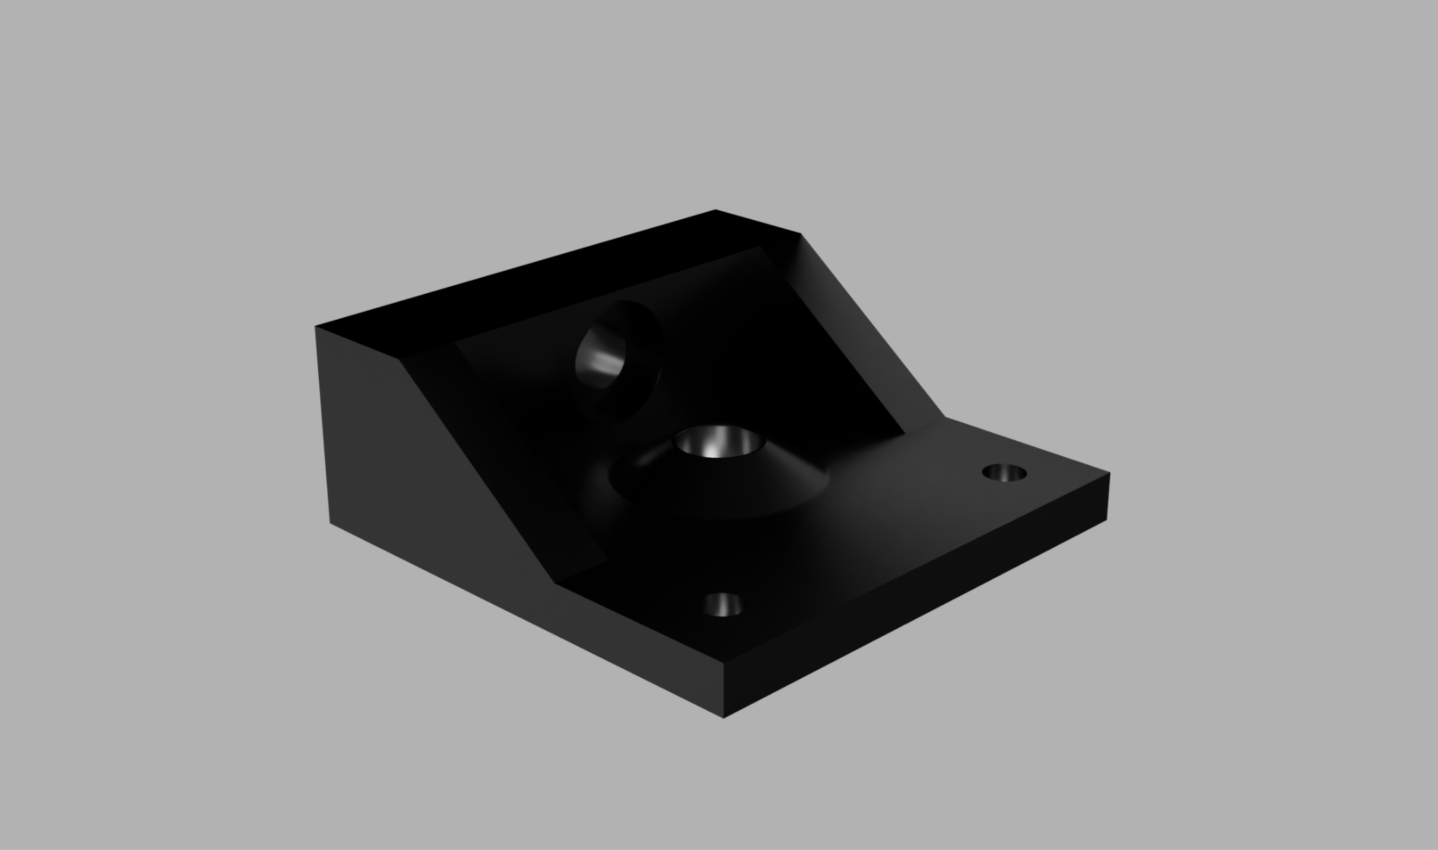

The reflector system is in the testing phase

Slide 11
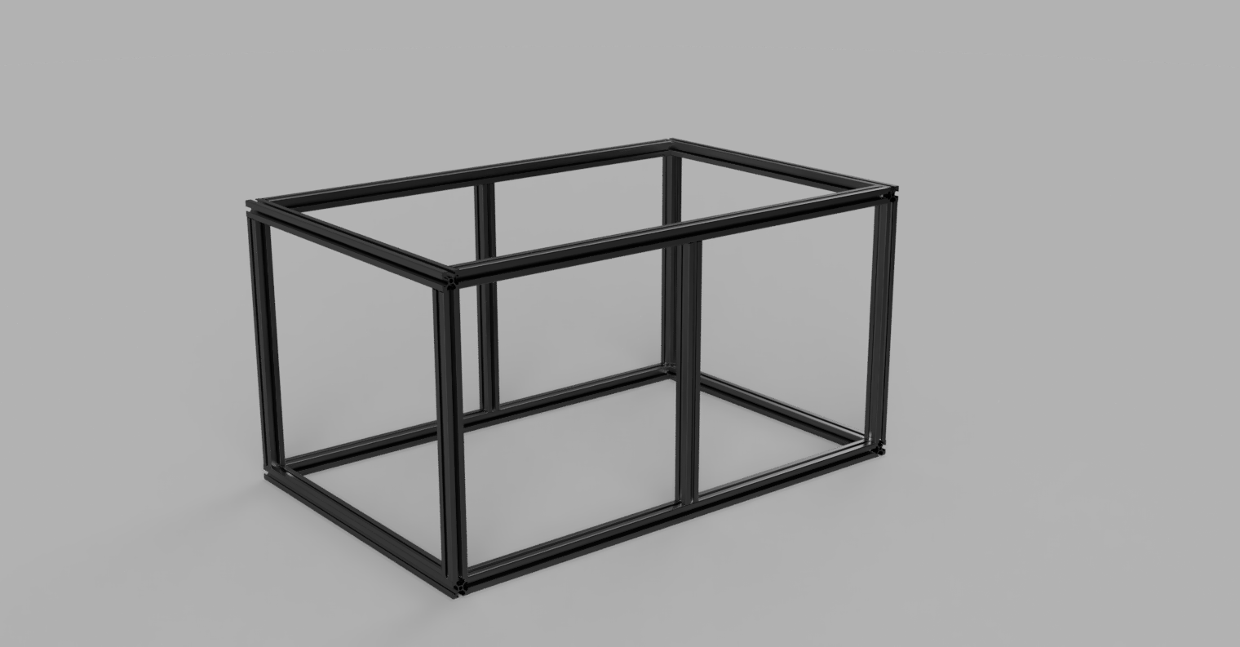
Frame is finished, constructed with aluminum extrusions.
Starting with 48-inch aluminum extrusions, we machined our frame to create a rectangular gantry that houses the solar-panels & the reflectors. The frame is held together by brackets & M6 screws inserted into the threaded ends of the extrusion.

Slide 12
Application Status
Microcontroller Functionality
The current system is able to measure the values of the ambient light intensity, battery temperature, and output power.
The system can also update our cloud hosted database with the previously mentioned values.
Web Application
People can create accounts to view different solar modules and create solar array instances in our database.
One can view the stored data from our cloud hosted database as a series of graphs in the analytics section of the website.

Slide 13
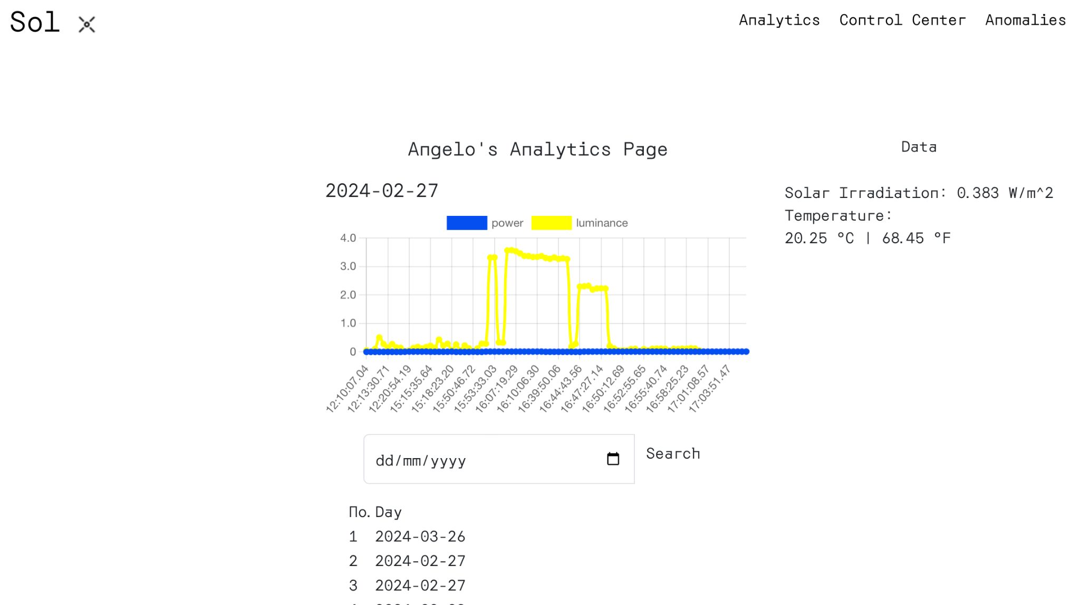
Web Application

Slide 14
Web application Overview
(Arrows show interacting modules)
React Client Application
NodeJS server operating on the cloud (e.g. Digital Ocean)
Flask or Node JS server on a microcontroller
React Components
API
API
Anomaly Detection
Visualizations
Express.js Api
Express.js or Flask API TBD
Trend Forecasting
Data will be received from the station periodically and stored on a MDB database (Post request).
Data measurements will be recorded and sent to the server periodically
API
Data will be received from the server responses (from post requests)
Cloud hosted Database
MongoDB
Controller
Data will be received from the powerplant using the developed API
Records Measurements

Slide 15
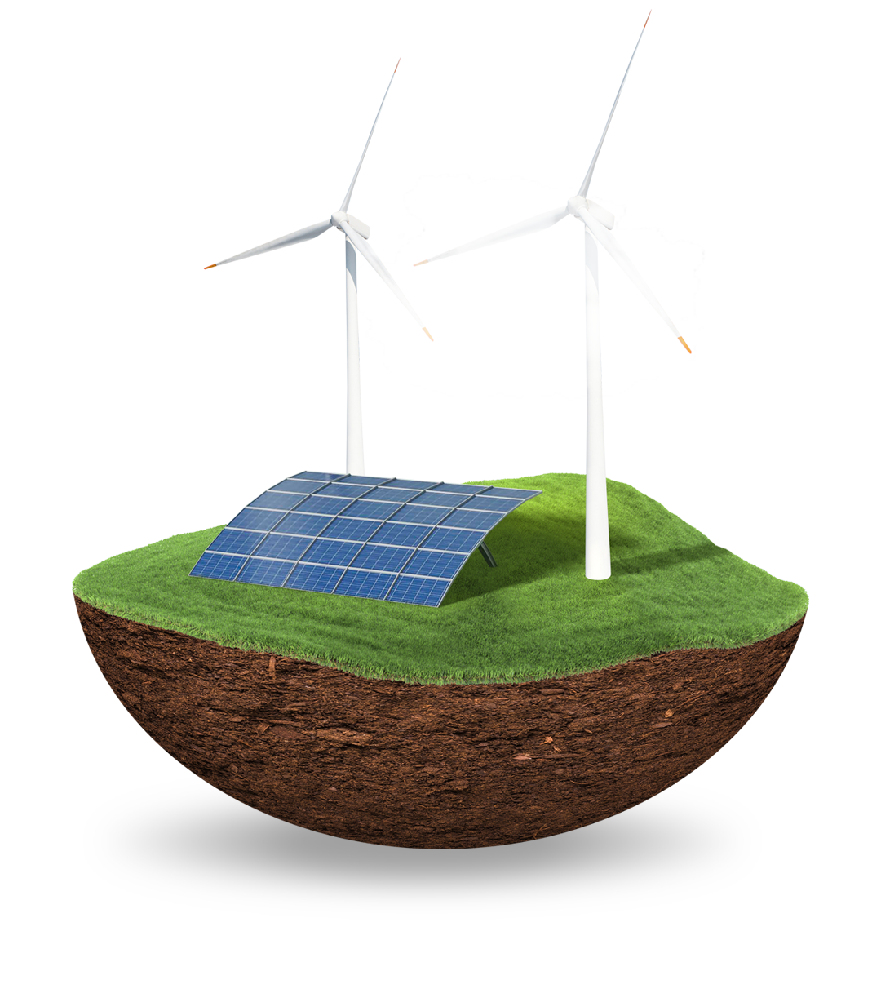
Next Steps

Slide 16
Future work will focus on select Key Point Indicators to measure progress
KPI’s for project completion
Frame Testing
PCB Assembly
Housing Manuf.
Web Server Anomaly Notif.
Add Limit Switches

Slide 17
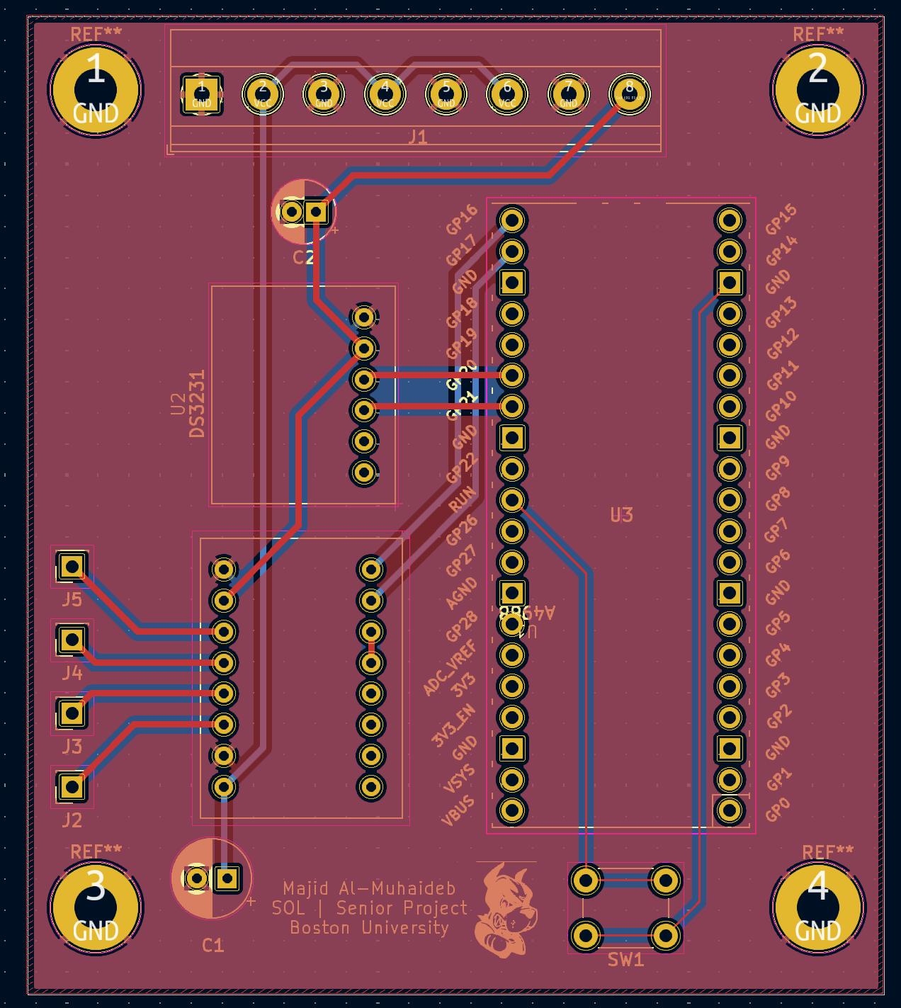
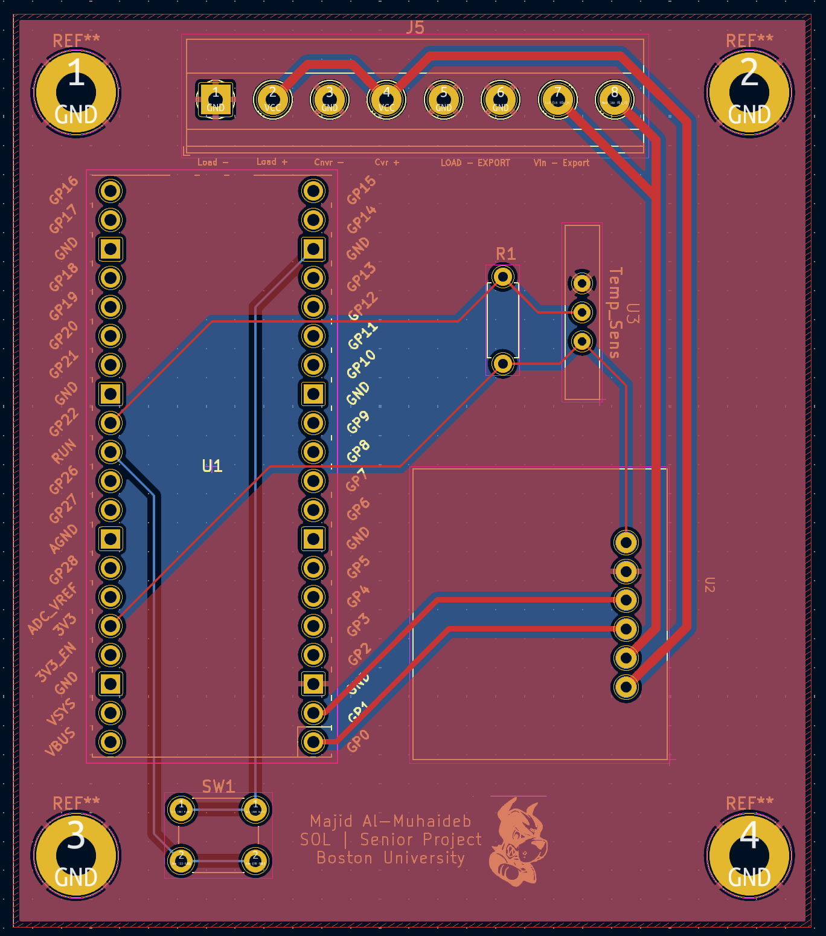
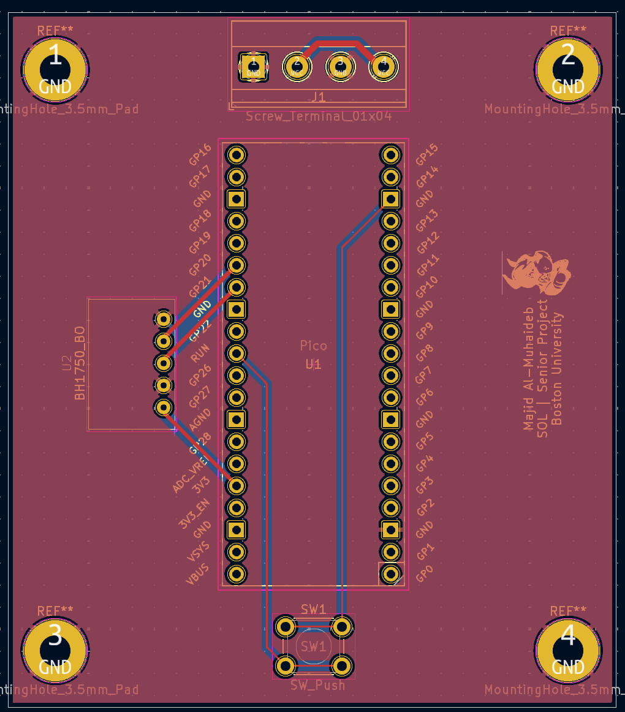
PCB’s are in. Need to be assembled & tested

Slide 18
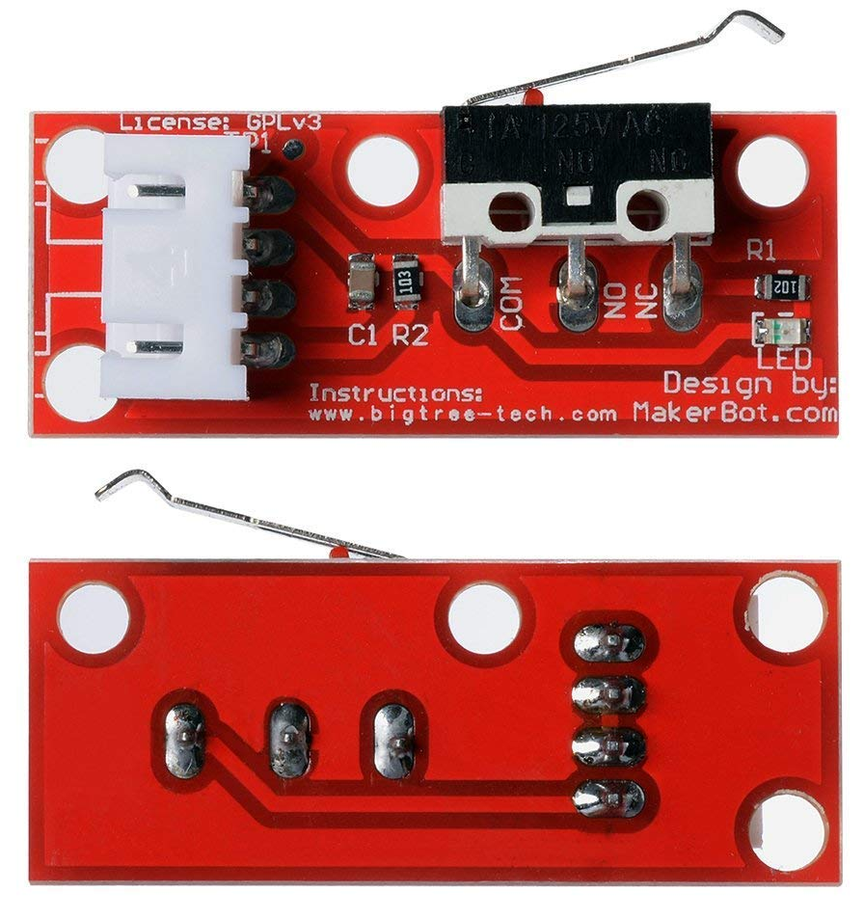
Control Next Steps
Manual motor control okay but…
Endstop Limit Switches!
More robust
Don’t require user input
Prevent reflectors from going past structure limits

Slide 19
The reflector system needs to be tested, integrating any feedback
Testing
Adjustment
Final Check
Printing
Assembly
Test performance of design
Make any necessary adjustments
Ensure system is completely finished and ready
Re-print parts with stronger material
Assemble new parts
We Are Here
->
->
->
Mid April

Slide 20
Application Next Steps
Microcontroller Functionality
The raspberry pi pico code must be updated to notify our users with an email when there is an anomaly in the plant’s operation
Web Application
Anomaly data must be displayed within the web application.
The list of data for each day should be paginated.
The website needs to be published and hosted.

Slide 21
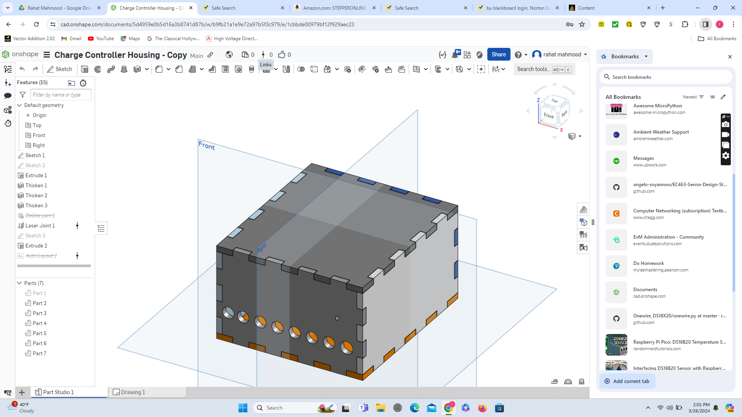
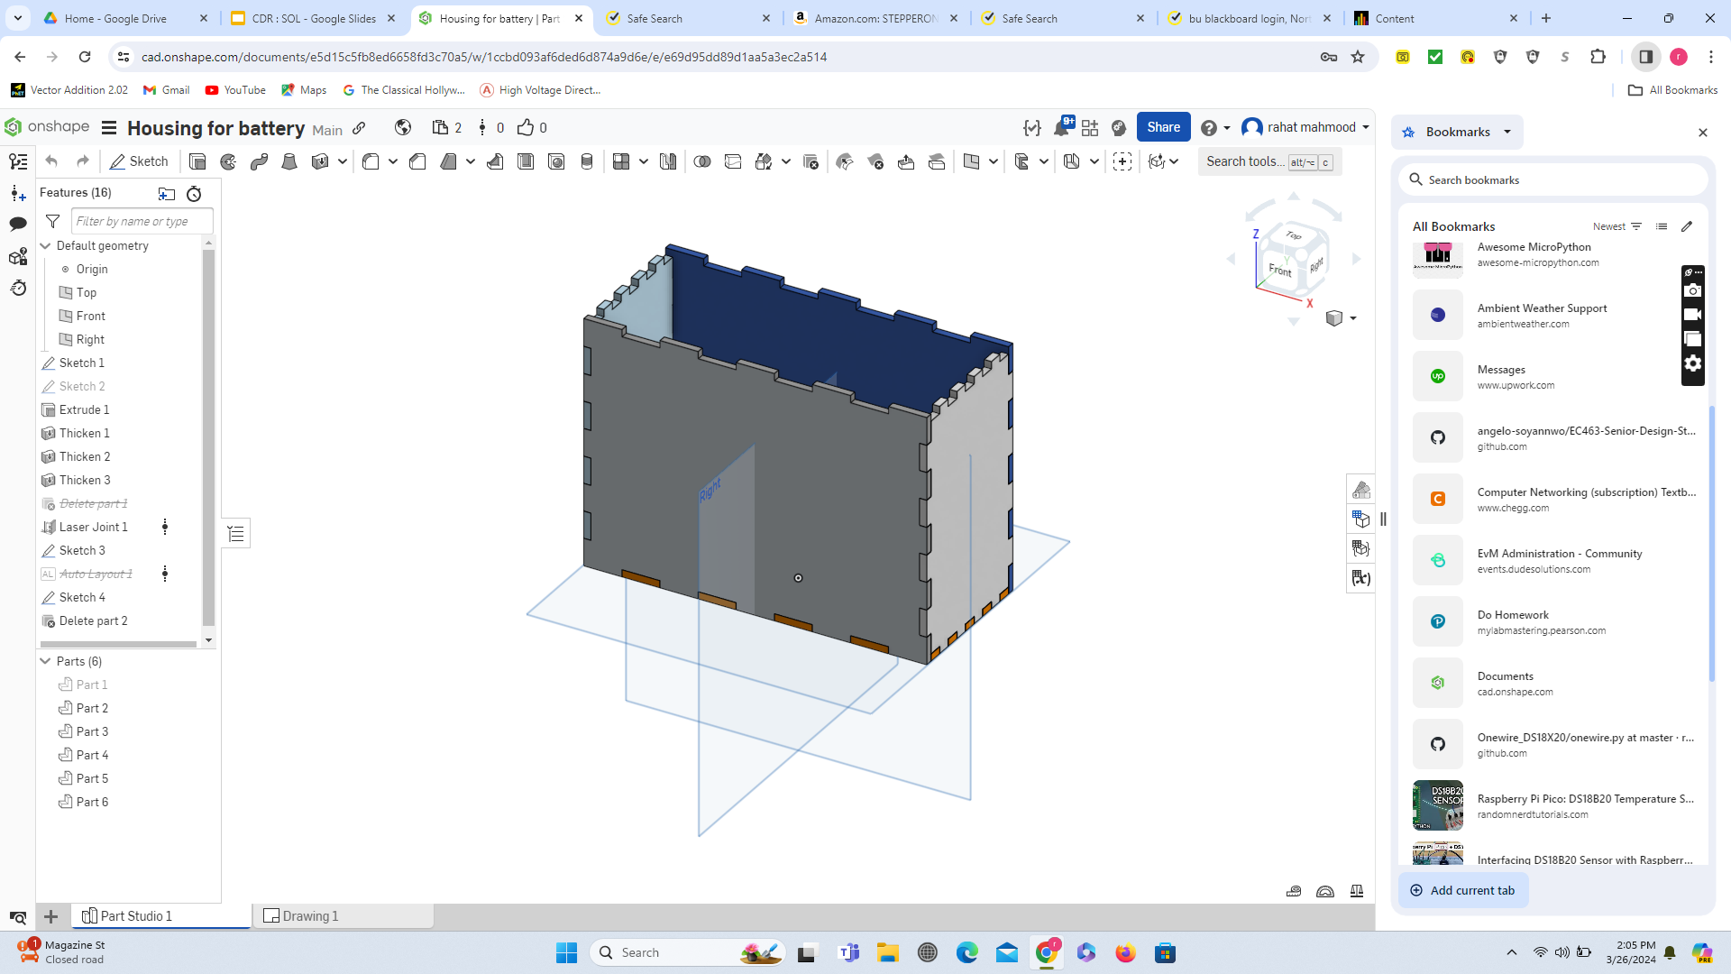
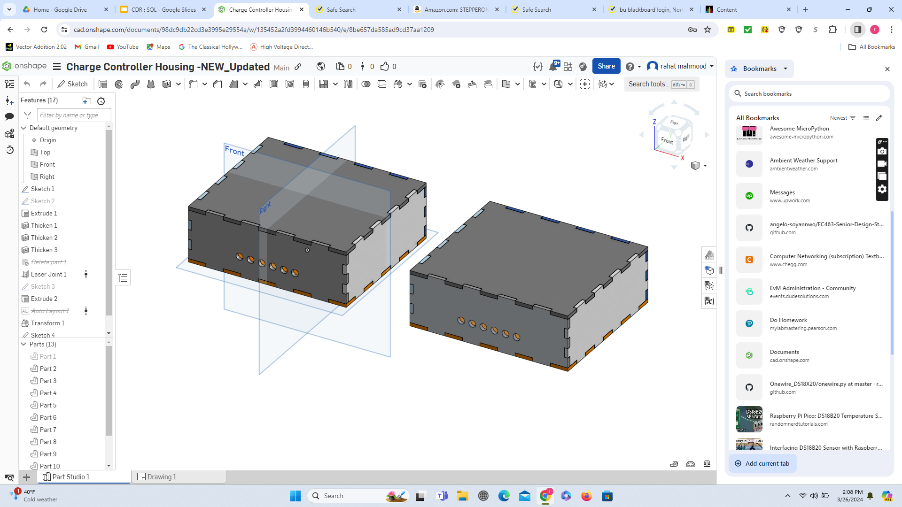
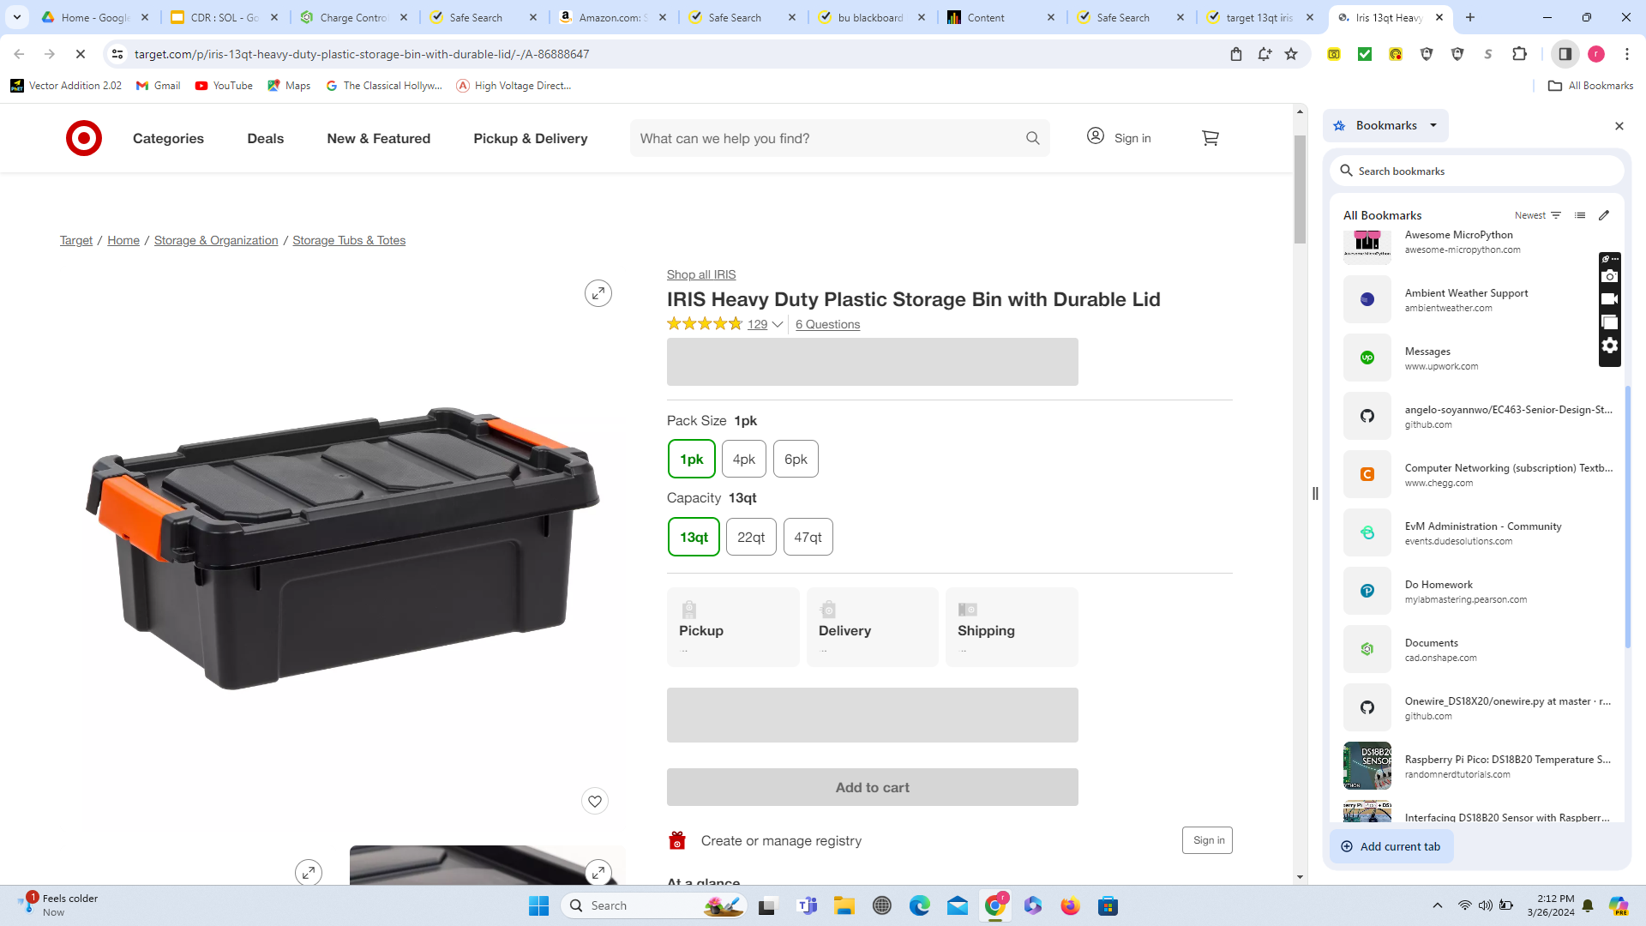
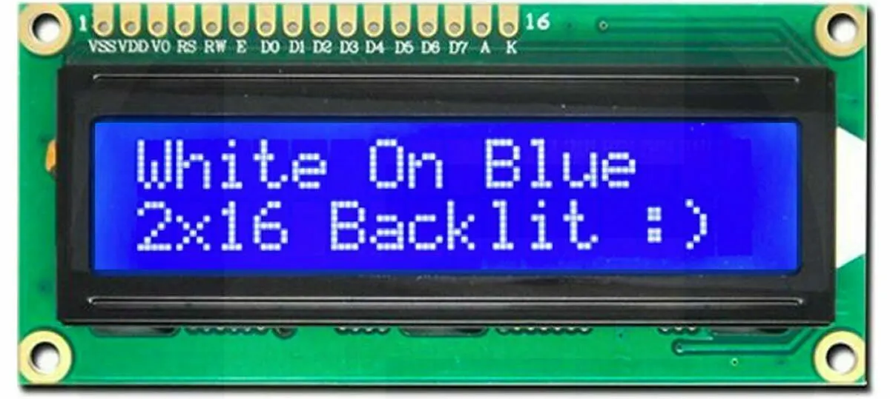
Housing
Done
(Acrylic Sheet)
For Monitoring and Control System
For 12V battery
For Solar Charge Controller
Installed inside
Installed Inside
Installed Inside
Attached on the side
LCD Monitor
Small Storage Box

Slide 22
Gantt Chart Slide
 | January |  |  | February
Task | 1/15 | 1/22 | 1/29 | 2/5 | 2/12 | 2/19 | 2/26
Microcontroller + battery housing design
Reflector control mechanism design
Web app: Total energy display
Torque and force analysis
Structure frame design
Housing construction
Reflector mechanism prototyping
Web app: current and average solar irradiance, visuals
Design Frame
Circuit build and testing (without data, simple motor movement)
Buy and integrate solar irradiation sensor
Design structure components + 3D print
Show the gantt chart and Clear referencing of progress and plans against milestones, Gantt chart plans
Everyone talks here.

Slide 23
 | March |  |  |  | April
Task | 3/4 | 3/11 | 3/18 | 3/25 | 4/1 | 4/8 | 4/15
Integrate monitoring system with server
Reflector control programming
Design & Order PCBs
Add LCDs to controls program
Circuit build and testing, full operation
Solder PCB
Full System Construction
Add limit switches
Web app: anomaly handling
Full System Testing
Publish Web App
Final Assembly

Slide 24
Conclusion
Web server will soon be published/hosted
Our system testing phase has begun
Team focus is on minor system adjustments and presenting a polished product

Slide 25
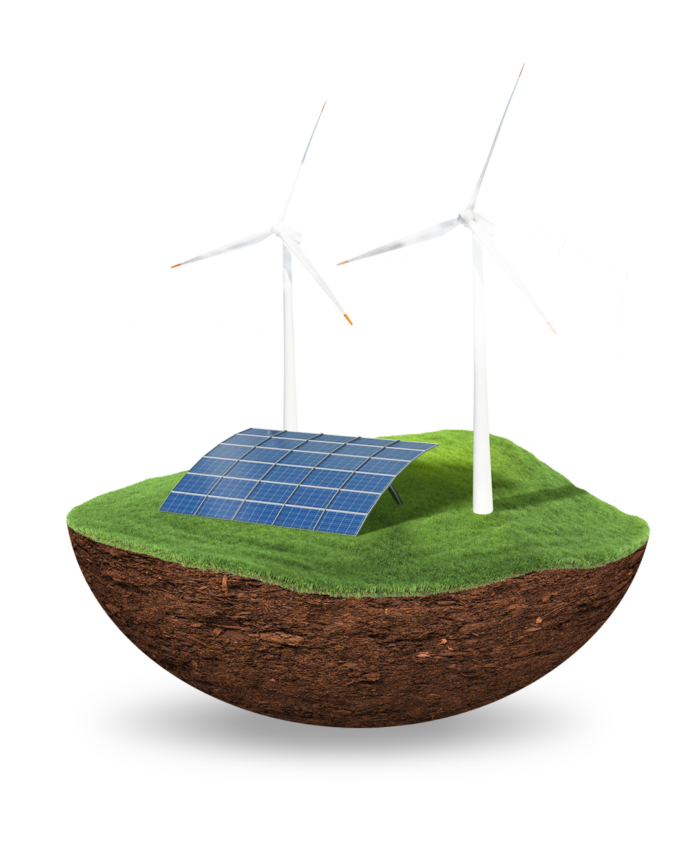
Thank You
This template was created by Slidesgo, with icons from Flaticon, and infographics & images from Freepik

